Slide 1


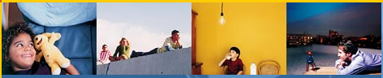
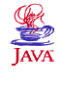
J2ME on Terminal Device
นายขจร เจียรนัยพานิชย์ 42010033
นางสาวจริยาพร บุญสังข์ 42010046
Advisor
ผศ.อภิเนตร อูนากูล
อ.ดุสิต นิยะโต

Slide 2

Agenda
Project Background
Objectives
Com86 Board
J2ME Technology
KVM Architecture
KVM Development

Slide 3


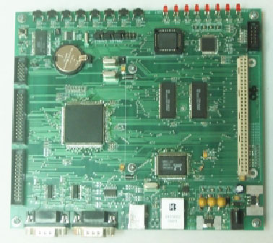

Project Background
J2ME
Application
Com86 Board
Write once run Anywhere

Slide 4
Objective
I can run
Java Application
Com86 Board

Slide 5



Managing Ubiquitous
Device Framework
- Embedded J2ME on Terminal Device
-Embedded Web service on Terminal Device
-Terminal Device
Device Management Station
Wireless Router
Device
16 Bit Device
Management Station
Network
PC based

Slide 6

Com86 Board

Slide 7
Com86 Board
- Micro Controller Am186CC 25 MHz
- Main Memory 1 MBytes
- Boot Memory 64 KBytes
- Ethernet with 10BaseT
- USB (USB Device)
- Storage 512 Kbytes ( can be extension)

Slide 8
J2ME

Slide 9
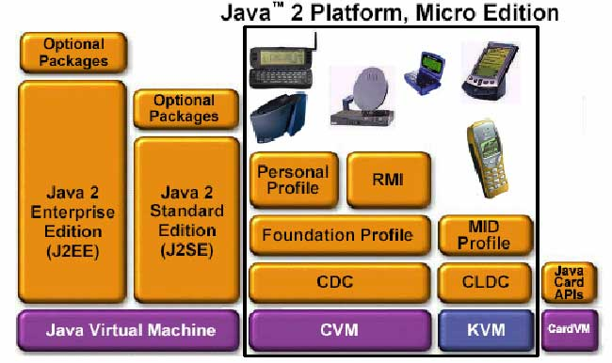
J2ME
This Project

Slide 10




Kilo Virtual Machine

Slide 11

KVM
What is KVM ?
KVM = Kilo Virtual Machine
A small footprint Java virtual machine
Few hundred kilobytes of total memory
16 bit processor
Implemented in C code

Slide 12
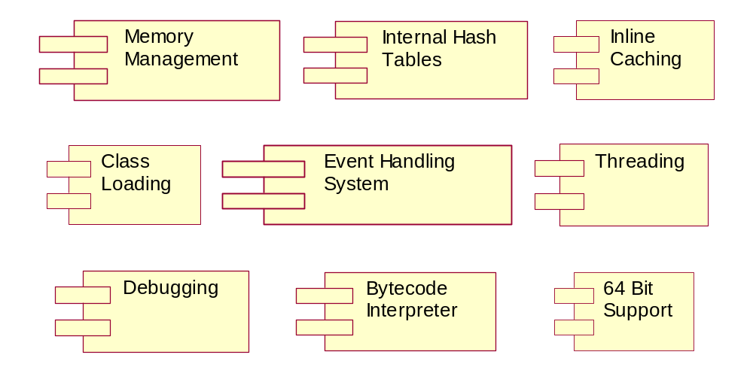
Component in KVM
KVM

Slide 13
Memory Management
KVM
Allocate Memory from OS
Manage Java Allocations
    Including heap compaction
Remove Garbage Objects

Slide 14
Object Layout in the KVM
KVM
GC header word (32 bits)
class pointer
monitirOrHashCode field
…the rest of the data…
Object ptr
Object Header
Length 24 bits
Type 6 bits
Static bit
 |  | 0 | 0
Mark bit

Slide 15
KVM
Garbage Collection in KVM
Automatic reclamation of unused memory
Based on a non-copying collector
Mark and Sweep Algorithm
Small and simple
Non-moving Object
Non-incremental

Slide 16
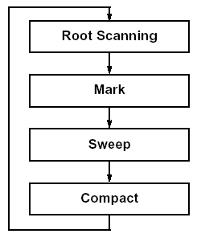
KVM
Garbage Collector
find root
identify garbage
find garbage on heap and de-allocate it.
collect all empty memory together

Slide 17
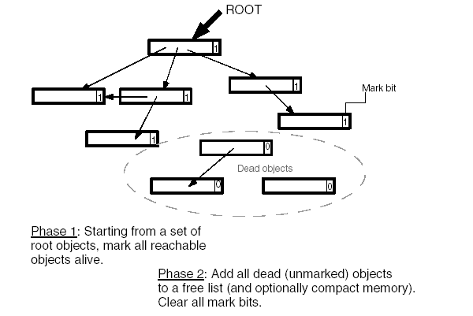
KVM
Mark and Sweep
Mark bit = 1 is Live.
Mark bit = 0 is Garbage.

Slide 18
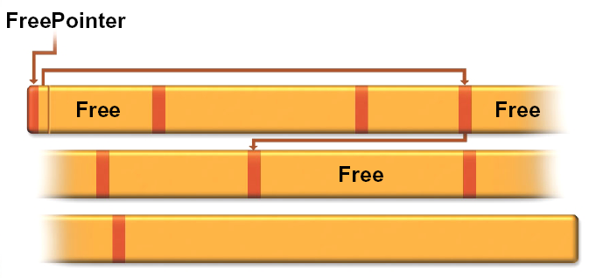
KVM
Free List Structure
Add garbage (dead object) to a free list.
Free List Header
Size
Next

Slide 19
Internal Hash Tables
KVM
Three system hashtables
ClassTable
InternStringTable
UTFStringTable

Slide 20
Inline Caching Structures
KVM
Deutsch-Schiffman style
set ENABLEFASTBYTECODES = 1
Code before optimization :
Code after optimization :
BC | PARAM
BF | ICIDX
8 bits
16 bits
8 bits
16 bits
BC = “SLOW” bytecode
PARAM = parameter for BC
BF = “FAST” bytecode
PARAM = inline cache index

Slide 21
Class Loading
KVM
FILEPOINTER
struct filePointerStruct; typedef struct filePointerStruct *FILEPOINTER;
InitializeClassLoading & FinalizeClassLoading
openClassfile & closeClassfile
loadBytesNoEOFCheck : n bytes
loadByte, loadShort, loadCell : 1,2,4 bytes
loadBytes : n bytes
skipBytes, getBytesAvailable : n bytes

Slide 22
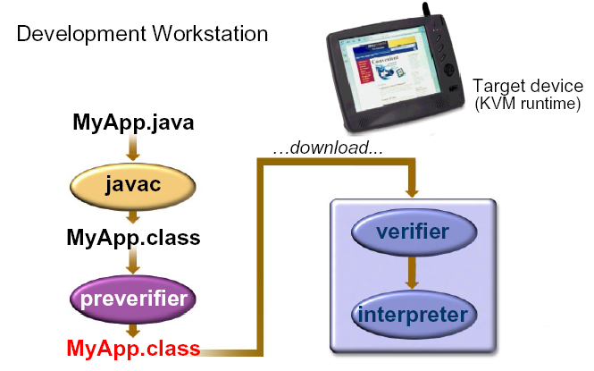
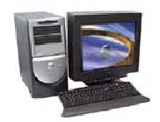
KVM
Class File Verification
Two-phase verification

Slide 23
Event Handling System
KVM
Synchronous Notification or Blocking
Polling in Java code
Polling in bytecode interpreter
Asynchronous Notification

Slide 24
Threading
KVM
All active threads kept in a simple linked queue
Given execution time based on priority
64 bit Support
Type | Description
long64 | A signed 64-bit integer.
ulong64 | An unsigned 64-bit integer.
Not support 64-bit integers :
  COMPILER_SUPPORT_LONG = 0
  BIG_ENDIAN or LITTLE_ENDIAN = 1

Slide 25
Steps in KVM
KVM
Memory Management
Hash Tables
Inline Caching
KVM Start Up
Class Loading
Load Java System Class
Class File Verifier
Event Handling
Load Main Class
Command Line Arg.
Threading System
Start the Interpreter
KVM Clean Up

Slide 26

KVM
Development

Slide 27
KVM Development
Java File
Virtual Machine
Platform Dependent
Operation System
Machine
VmCommon | VmExtra
VmPort

Slide 28
KVM Development
Problem
Com86
    - DOS OS
    - Limited Memory
    - No Multitasking

Slide 29
KVM Development
Problem
Include , Library
    Windows.h , Winbase.h ,
    winsock.h , winsock2.h ,
    proceess.h
Dos.h , time.h , malloc.h ........

Slide 30
KVM Development
Problem
Compiler
    KVM Project not design for Borland C
    Library Different
    Link Problem
    Longname
void nativeImplement
void nativeImplement
void nativeImplement
void nativeImplement
setjmp.h != setjmp.h
VC DOS
fakeStaticMemory.c
=> fakeSt~1.c

Slide 31
KVM Development
Problem
KVM size
    Runtime + Debug = 557k
    Average size is 264k
    Com86 had 256k

Slide 32
KVM Development
KVM Development
Example Implement
#include<winbase.h>
SYSTEMTIME st;
//initialize
memset(&st, 0, sizeof(st));
memset(&date, 0, sizeof(date));
GetSystemTime(&st);
// initialize calendar fields
date[YEAR] = st.wYear;
date[MONTH] = st.wMonth;
date[DAY_OF_MONTH] = st.wDay;
date[HOUR] = st.wHour;
date[MINUTE] = st.wMinute;
date[SECOND] = st.wSecond;
date[MILLISECOND] = st.wMilliseconds;

Slide 33
KVM Development
KVM Development
Example Implement
#include<time.h>
clock_t clk;
struct tm *tmP = NULL;
memset(&date, 0, MAXCALENDARFLDS);
time(&clk);
tmP = localtime(&clk);
/* initialize the calendar fields */
date[YEAR] = tmP->tm_year;
date[MONTH] = tmP->tm_mon;
date[DAY_OF_MONTH] = tmP->tm_mday;
date[HOUR] = tmP->tm_hour;
date[MINUTE] = tmP->tm_min;
date[SECOND] = tmP->tm_sec;

Slide 34
KVM Development
Summary Problem
Windows is Different with DOS
Variable 32 bit
Multitasking
Compiler
Estimation Failure

Slide 35
KVM Development
Project Summary
Platform-Depentdent (Data Type , Time)
only Dos Library
no Threading , Networking
AllocateMemory
KVM size = 160k

Slide 36
Questions are welcome…..

Slide 37
Thanks You

